Slide 1

Domain III Practicum
Information Systems Auditing
Class V

Slide 2
Class Recap

Slide 3
Class Roadmap
IT Governance: Concept
IT Governance: Audit Program
IS Acquisition and Development
IS Implementation
Practicum on Domain 3
Navigating International Standards (GTAG)
Mid-Term Exam Prep
Mid-Term Exam
IS Operation & Business Resilience I
IS Operation & Business Resilience II
Protection of Information Assets I
Protection of Information Assets II
Intro to SQL for Auditing
Case Study: Auditing with SQL
Final Exam Prep
Final Exam

Slide 4
Covered So Far
IT Governance in concept
IT Governance through COBIT 2019 standard
Using COBIT 2019 as a criteria for IT Governance Audit
How Systems are Acquired & Developed
How Systems are Implemented
Remember, the first half this class will cover domains in CISA Review, as follows:
IS Auditing Process
IT Governance
IS Acquisition, Development, and Implementation
IS Operations and Business Resilience
Protection of Information and Assets

Slide 5

Reflection - A Note on Adaptation
The recent syllabus change is not ideal. It is disappointing. I understand that some of you may feel annoyed by it. Me too.
But here is the thing: disappointment will come and go far more often in life than we expect. In a world full of surprises—both good and bad—it is naïve to assume that everything will always go according to plan.
When difficulties come, avoid equipping yourself with the belief that you are the biggest victim or that your burden is uniquely difficult. What matters more is how you respond and act in a world full of constraints.
And here we are: adjusting, adapting, and still trying to do our best despite the absurdity.
Photo by Bastien Hervé on Unsplash

Slide 6
Feasibility Analysis
Prototyping

Slide 7
Intro

Slide 8
Gist of Domain 3 (again)
Acquisition
Development
Implementation
Decide what's best for us, and acquire it the best way possible
Peran auditor:
Memastikan keputusan akuisisi punya justifikasi yang kuat dan proses pengadaan bebas dari risiko (conflict of interest, vendor lock-in, dll.)
Build what we need, the right way, with the right controls in place.
Peran auditor:
Memastikan proses pembangunan sistem mengikuti metodologi yang disepakati, kontrol keamanan ditanamkan sejak awal, dan setiap perubahan terdokumentasi dan terotorisasi.
Deliver the system the best way possible, and make sure what's built is what was needed.
Peran auditor:
Memastikan transisi ke sistem baru berjalan terkontrol, pengguna siap, dan manfaat yang dijanjikan di business case benar-benar terealisasi pasca go-live.

Slide 9
Acquisition

Slide 10
Let’s Math
In this practicum, let’s do some Capital Budgeting Techniques using quantitative metrics such as:
Payback Period
Net Present Value
Internal Rate of Return

Slide 11
Time Value of Money
The time value of money is the idea that money available today is worth more than the same amount in the future due to its potential earning capacity. This principle is foundational in finance and investing.
Illustration:
Imagine you have $100 today. You can invest this money in a bank account that earns 5% interest per year. In one year, your $100 will grow to $105. This growth reflects the time value of money.
Now, if someone offers you $105 a year from now, you might think it's equivalent to having $100 today because you know you can invest $100 today and get $105 in a year. Here, the 5% interest rate is your discount rate.

Slide 12
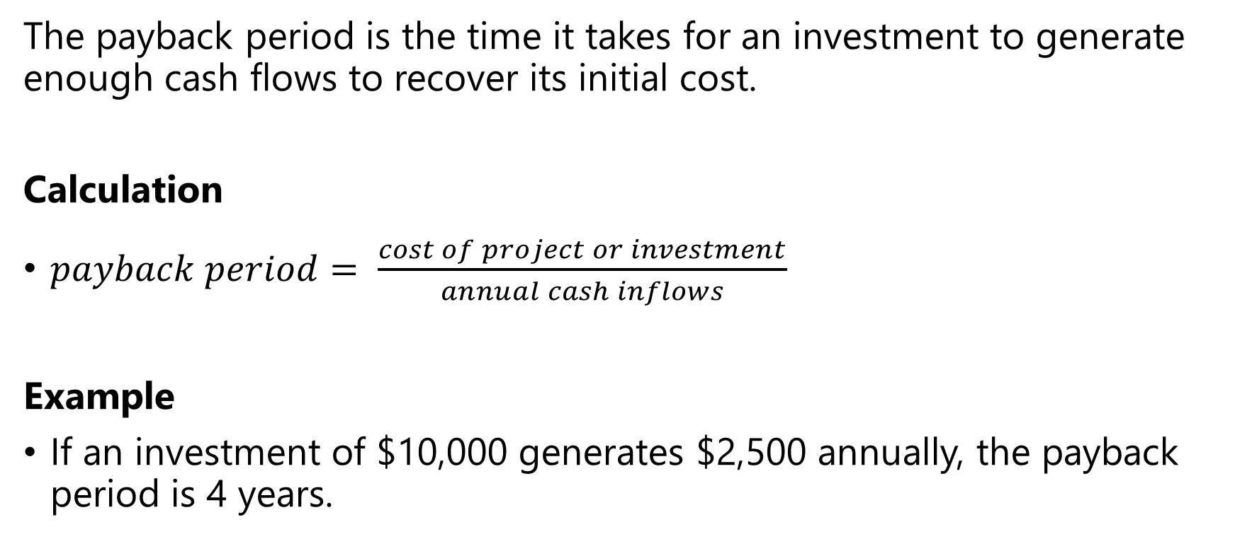
Payback Period
The payback period is the time it takes for an investment to generate enough cash flows to recover its initial cost.
Calculation
$payback period= \frac{cost of project or investment}{annual cash inflows}$
Example
If an investment of $10,000 generates $2,500 annually, the payback period is 4 years.
Kapan balik modal?

Slide 13
Why Payback Period Matters?
Simplicity: Easy to understand and calculate.
Liquidity Focus: Emphasizes the time required to recover the initial investment.
Risk Assessment: Shorter payback periods reduce investment risk.
The less, the better (more liquid)

Slide 14
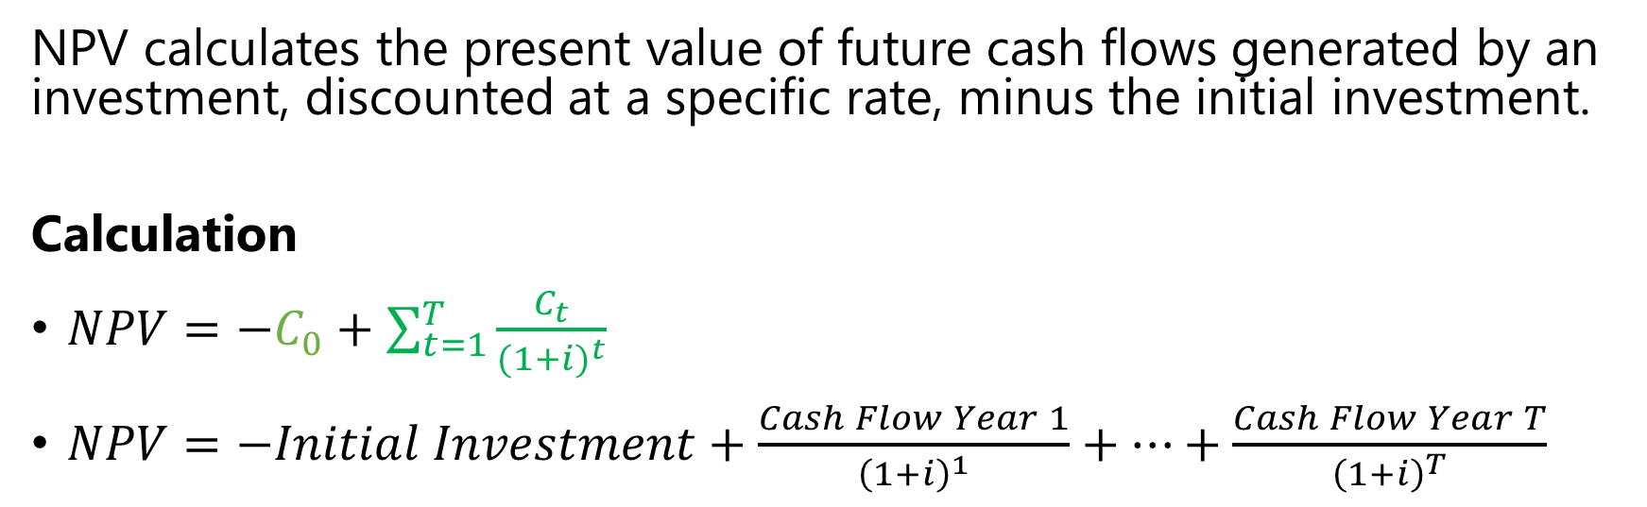
Net Present Value (NPV)
NPV calculates the present value of future cash flows generated by an investment, discounted at a specific rate, minus the initial investment.
Calculation
$NPV=−C_{0}+\sum_{t=1}^{T}{\frac{C_{t}}{{(1+i)}^{t}}}$
$NPV=−Initial Investment+\frac{Cash Flow Year 1}{{\left(1+i\right)}^{1}}+…+\frac{Cash Flow Year T}{{\left(1+i\right)}^{T}}$
cost
benefit
C | : Cash Flow
i | : Discount Rate
t | : Time Period
The discount rate is the rate used to determine the present value of future cash flows. It reflects the time value of money, which means that money received today is worth more than the same amount received in the future due to its potential earning capacity.

Slide 15
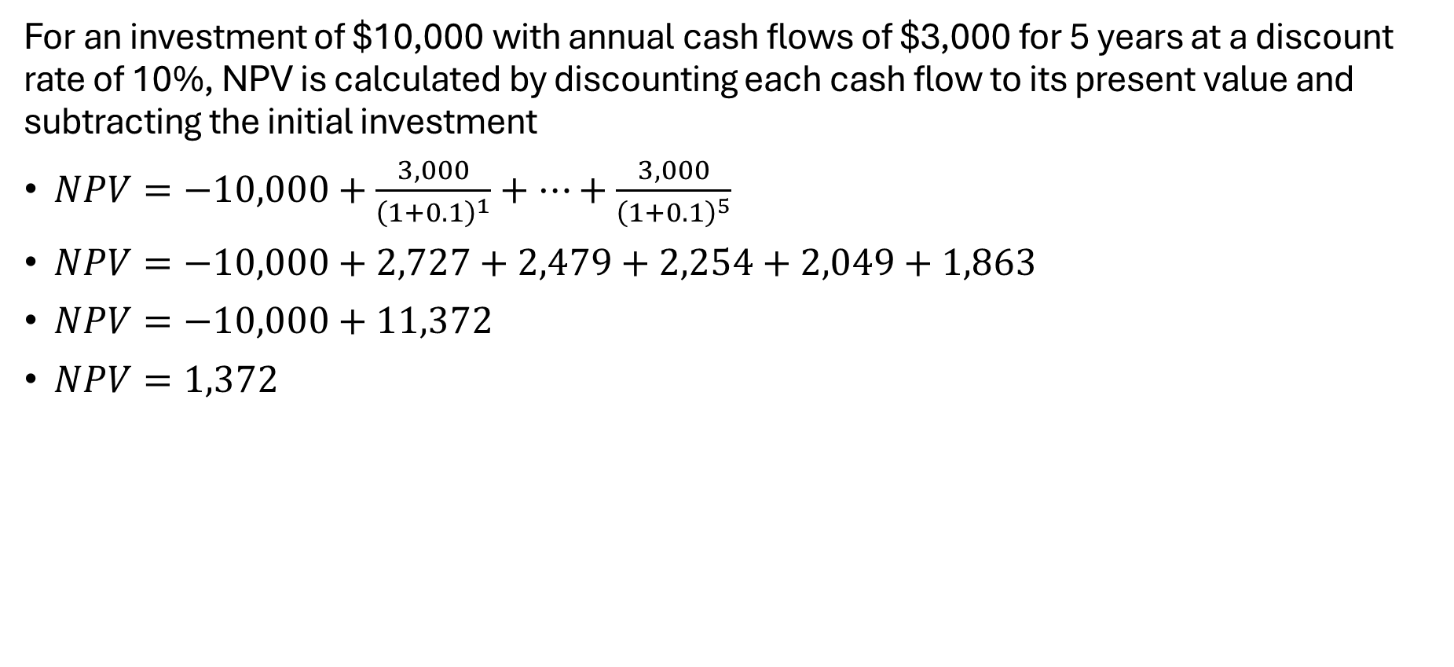
Net Present Value (NPV) - Example
For an investment of $10,000 with annual cash flows of $3,000 for 5 years at a discount rate of 10%, NPV is calculated by discounting each cash flow to its present value and subtracting the initial investment
$NPV=−10,000+\frac{3,000}{{\left(1+0.1\right)}^{1}}+…+\frac{3,000}{{\left(1+0.1\right)}^{5}}$
$NPV=−10,000+2,727+2,479+2,254+2,049+1,863$
$NPV=−10,000+11,372$
$NPV=1,372$

Slide 16
Importance of NPV
Time Value of Money: Accounts for the time value of money.
Profitability Measure: Direct measure of expected profitability.
Decision Making: Positive NPV indicates value generation.
The more, the better (more profitable)

Slide 17
Internal Rate of Return (IRR)
IRR is the discount rate that makes the NPV of all cash flows from a project equal to zero. It represents the project's potential return and helps in comparing different investments.
Calculation:
Solve for i (discount rate) in the NPV formula where NPV = 0.
Example:
For an investment of $12,000 with annual cash inflows of $4,000 for 4 years, IRR is the rate at which the discounted cash flows equal the initial investment.

Slide 18
Importance of IRR
Rate of Return: Provides the effective interest rate of the project.
Comparison Tool: Allows easy comparison between projects.
Investment Attractiveness: Assesses whether a project meets the required rate of return.
The more, the better (more profitable)

Slide 19
Case Study I
A company is considering investing in a new Accounting Information System (AIS) to improve efficiency and reduce errors. The initial investment required is $20,000. The expected annual benefits from increased efficiency and error reduction are $6,000. The system has a useful life of 5 years.
Tasks:
Simple Cost-Benefit Analysis: Evaluate whether the benefits of the proposed system justify the costs involved.
Payback Period: Calculate the time required for the net savings to equal the initial investment.
Net Present Value (NPV): Discount (10%) future cash flows to their present value to determine the overall profitability.
Internal Rate of Return (IRR): Determine the effective interest rate that results in an NPV of zero.

Slide 20
Case Study II
A company is considering investing in a new Accounting Information System (AIS) to improve efficiency and reduce errors. The initial investment required is $25,000. The expected annual benefits from increased efficiency and error reduction vary as follows:
Year 1: $5,000
Year 2: $7,000
Year 3: $9,000
Year 4: $11,000
Year 5: $13,000
Tasks:
Calculate Payback Period, Net Present Value (NPV) with 10% Discount Rate, and Internal Rate of Return (IRR)

Slide 21
Case Study III
A company is considering three AIS Software to purchase as follows:
AIS Software | Implementation Cost | Annual Cost | Annual Expected Savings
SOP Accounting | $50.000 | $400 | $15.000
Tangkar Solution | $40.000 | $500 | $12.000
Orange NetSuite | $20.000 | $2.000 | $10.000
Assumed discount rate is 10%.
Which option should be picked based on economic feasibility for the next 5 years?

Slide 22
Case Study IV
A company is considering three options for implementing a new Accounting Information System (AIS):
Purchase: Buying a ready-made AIS from a vendor.
Initial Investment: $30,000
Annual Maintenance Costs: $5,000
Expected Annual Benefits: $15,000
Useful Life: 5 years
Outsource: Hiring an external firm to develop the AIS.
Initial Investment: $35,000
Annual Maintenance Costs: $4,000
Expected Annual Benefits: $16,000
Useful Life: 5 years
In-House Development: Developing the AIS internally using the company's resources.
Year | Expected Costs | Expected Benefits
0 | Wages: $3.000 Infrastructure: $5.000 Software Procurement: $1.000 | -
1 | Wages: $5.000 Infrastructure: $2.000 Software Procurement: $1.500 | -
2 | Training: $1.000 | $15.000
3 | Training: $1.000 | $15.000
4 | - | $15.000
5 | - | $15.000
Assumed discount rate is 10%.
Which option should be picked based on economic feasibility?

Slide 23
Case Study V
A company has sent multiple Request for Proposal (RFP) for new AIS development. So far, four proposals have been acquired in response to those RFP. You are tasked to do economic feasibility analysis on acquired proposals using Payback Period, NPV, and IRR.
Expected Cost:
Company | Year 0 | Year 1 | Year 2 | Year 3 | Year 4 | Year 5
Pluit | $7.000 | $8.000 | $9.000 | $10.000 | $5.000 | $5.000
Pewege | $10.000 | $10.000 | $10.000 | $2.000 | $2.000 | $2.000
GMPG | $25.000 | $3.000 | $3.000 | $3.000 | $3.000 | $3.000
YEE! | $8.500 | $8.500 | $8.500 | $8.500 | $8.500 | $8.500
Expected Savings:
Company | Year 1 | Year 2 | Year 3 | Year 4 | Year 5
Pluit | $2.000 | $4.000 | $5.000 | $10.000 | $20.000
Pewege | $3.000 | $4.000 | $5.000 | $12.000 | $15.000
GMPG | $2.000 | $13.000 | $13.000 | $13.000 | $13.000
YEE! | $10.000 | $10.000 | $10.000 | $10.000 | $10.000

Slide 24
Development

Slide 25
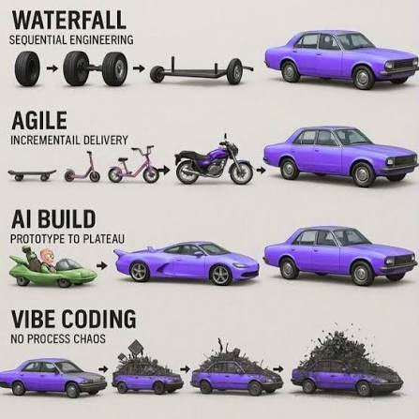
System Development Is Different With AI
Developing software is the job AI is very good at
But it’s not coming without risk

Slide 26
Agile Methodologies
A guiding philosophy and set of principles for developing information systems in an unknown, rapidly changing environment.
Key Principles:
Responding to change over following a plan
Emphasizing individuals and interactions over processes and tools
Customer collaboration over contract negotiation
Producing quality software over comprehensive documentation

Slide 27
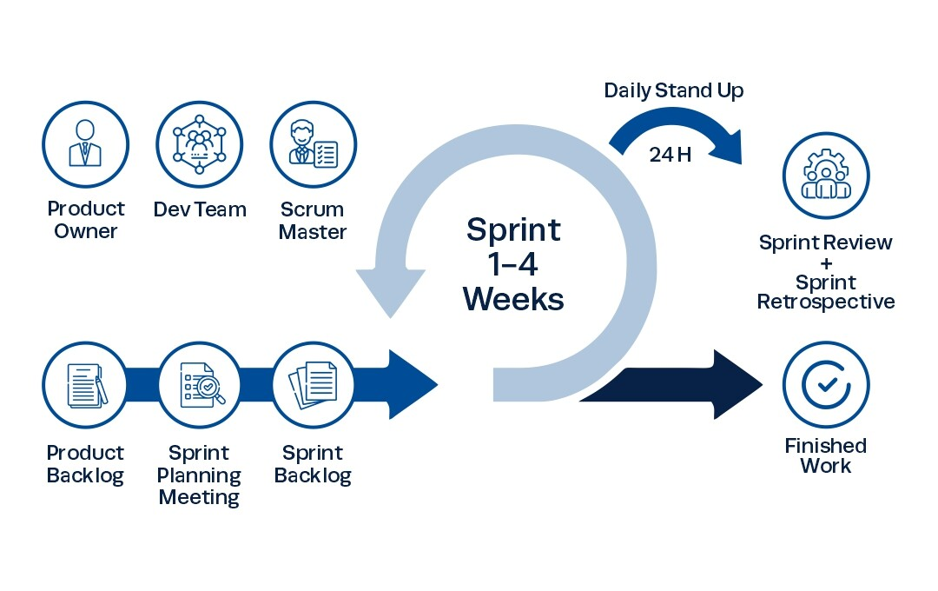

Agile Methodologies: Scrum
Scrum
Iterative and incremental development process
Roles: Product owner, scrum team, scrum master
Sprints: Short, focused development cycles
Scrum is like a relay race where each team member runs a short distance, hands off the baton, and the next member continues. This ensures continuous progress and quick adjustments.

Slide 28
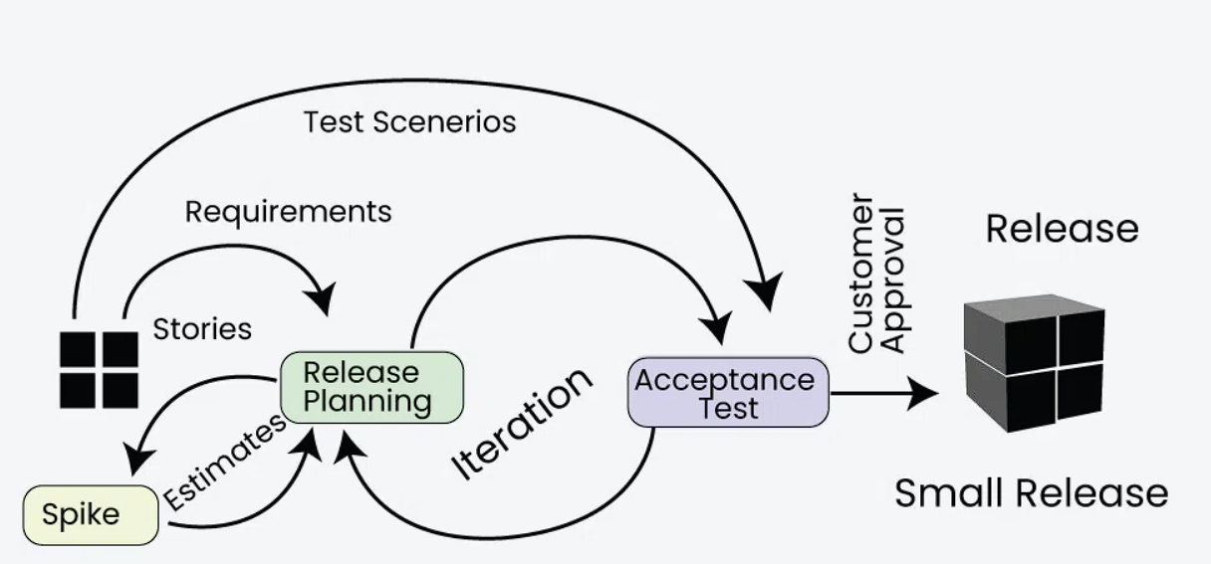
Agile Methodologies: Extreme Programming (XP)
XP
Two-person programming teams
Short development cycles with frequent releases
Extensive testing and customer feedback
XP is like a pair of chefs working together to create a dish, constantly tasting and adjusting the recipe to ensure it meets the customer's expectations.

Slide 29
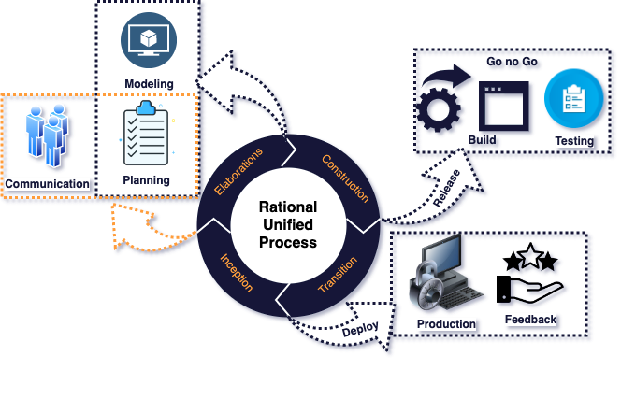
Agile Methodologies: Unified Process
Unified Process
Iterative development with executable architecture baseline
Unified Process is like constructing a building in phases, starting with the foundation, then the structure, and finally the finishing touches, ensuring each phase is solid before moving to the next.

Slide 30
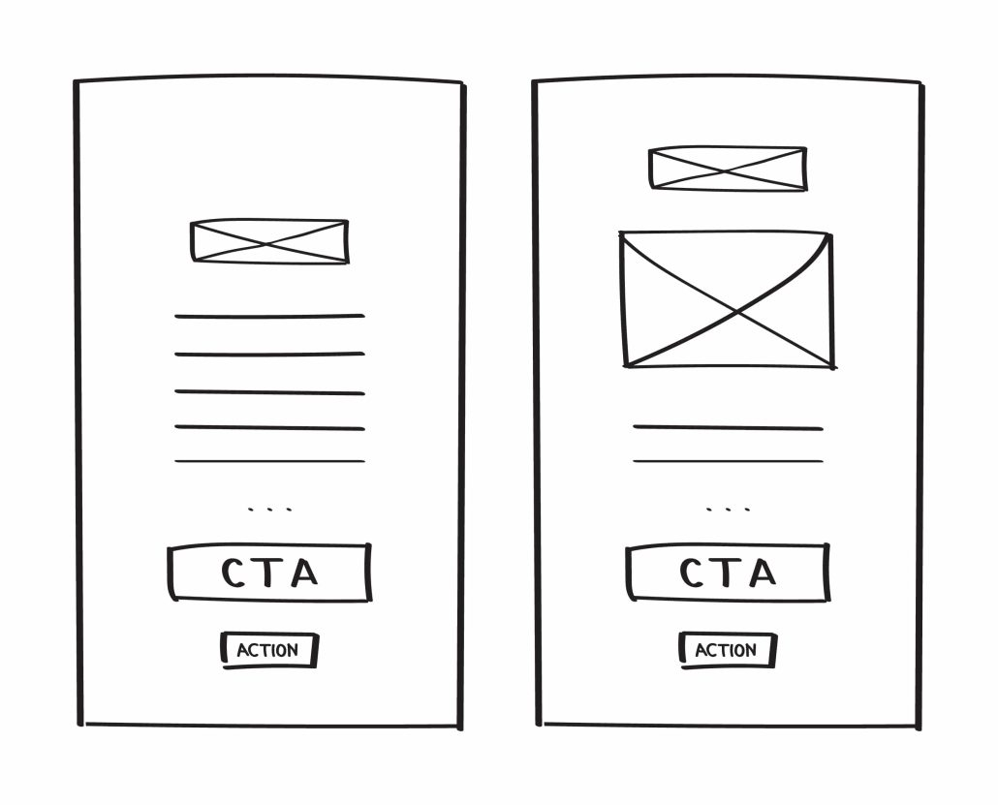
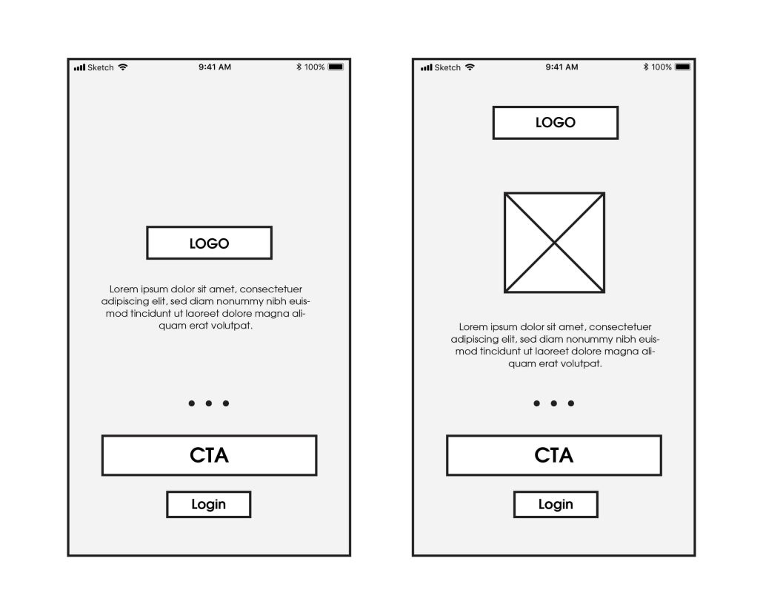
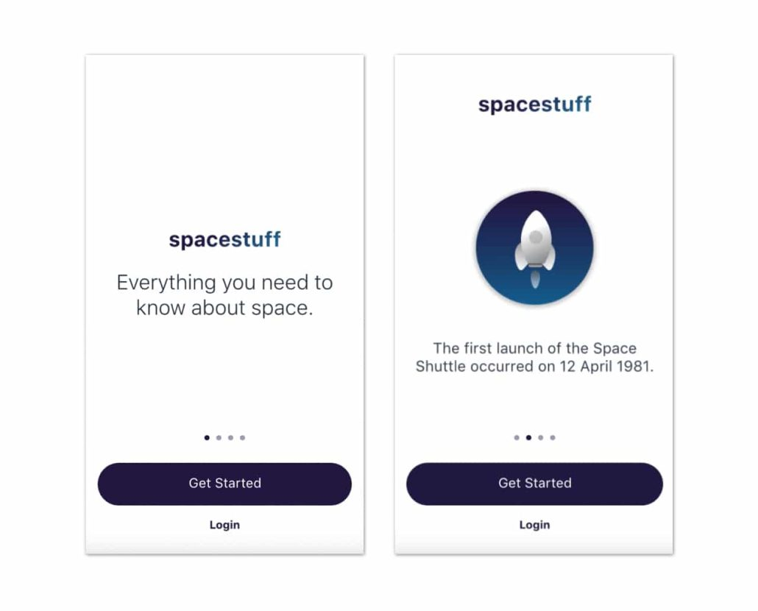
Prototyping – The Old Way
Low Fidelity
Mid Fidelity
Hi Fidelity
Pen & Paper
Prototyping App
Similar tech with final product

Slide 31


Prototyping – The AI Way
Hi Fidelity

Slide 32
Let’s Try Creating A Prototype with AI
APPLICATION: Create a Student Attendance Dashboard for university lecturers.
TARGET USERS: Lecturers and academic staff.
MAIN FEATURES:
Dashboard cards showing total students, present students, absent students, and attendance percentage.
Attendance table containing student names and attendance status.
Search box to search students.
Filter by attendance status.
Simple attendance chart using CSS or Canvas.
Responsive design.
COLOR THEME: Blue and white.
DESIGN STYLE: Modern dashboard.
LAYOUT: Left sidebar navigation and top header.
ADDITIONAL COMPONENTS:
User profile card.
Notifications panel.
Current date and time.
Use realistic sample data.
Generate only the complete HTML code.
You are a professional front-end developer.
Create a SINGLE HTML file containing:
HTML
CSS
JavaScript
Requirements:
Everything must be inside one .html file.
Do not use any external libraries or frameworks.
Do not use React, Vue, Angular, Bootstrap, Tailwind, or CDN.
The page must be fully responsive.
Use modern UI design principles.
Use semantic HTML elements.
Include smooth animations and hover effects.
The code must be clean and well-commented.
The application must work by simply opening the HTML file in a browser.
Generate complete code only.

Slide 33
Let’s Try Creating A Prototype with AI
APPLICATION: Create a Student Attendance Dashboard for university lecturers.
TARGET USERS: Lecturers and academic staff.
MAIN FEATURES:
Dashboard cards showing total students, present students, absent students, and attendance percentage.
Attendance table containing student names and attendance status.
Search box to search students.
Filter by attendance status.
Simple attendance chart using CSS or Canvas.
Responsive design.
COLOR THEME: Blue and white.
DESIGN STYLE: Modern dashboard.
LAYOUT: Left sidebar navigation and top header.
ADDITIONAL COMPONENTS:
User profile card.
Notifications panel.
Current date and time.
Use realistic sample data.
Generate only the complete HTML code.
You are a professional front-end developer.
Create a SINGLE HTML file containing:
HTML
CSS
JavaScript
Requirements:
Everything must be inside one .html file.
Do not use any external libraries or frameworks.
Do not use React, Vue, Angular, Bootstrap, Tailwind, or CDN.
The page must be fully responsive.
Use modern UI design principles.
Use semantic HTML elements.
Include smooth animations and hover effects.
The code must be clean and well-commented.
The application must work by simply opening the HTML file in a browser.
Generate complete code only.
33

Slide 34
Evaluate, Rebuild
Now that you have your initial design, ask AI to modify it using prompt of your own words

Slide 35
Methodologies In A Nutshell
 | Waterfall | Agile (Scrum) | RAD
Pendekatan | Linear-sekuensial | Iteratif, sprint 2–4 minggu | Prototyping cepat, user feedback intensif
Fleksibilitas | Rendah | Tinggi | Tinggi
Dokumentasi | Sangat lengkap | Minimal | Terbatas
Keterlibatan User | Di awal & akhir saja | Terus-menerus | Sangat intensif
Kemudahan Audit | Tinggi | Rendah–Sedang | Rendah
Risiko Utama | Perubahan mahal di tengah jalan | Scope creep, dokumentasi lemah | Technical debt, desain terburu-buru
Cocok Untuk | Kebutuhan stabil, regulated industry | Produk digital dinamis | Proyek cepat, skala kecil–menengah

Slide 36
Implementation

Slide 37
Remember These Guys
Old System
New System
Direct Conversion
Old System
Parallel Conversion
New System
Old System
New System
Phase-in Conversion
Old System
New System
Pilot Conversion

